Slide 1
Model Selection
:Reliability Check
Background: Many Predictors, Few True Effects.
Method: Backward Stepwise (AIC).
The Problem: Invalidates P-values- Selection Bias
→ Goal: Demonstrate how p-values become invalid through simulation.

Slide 2
objectives
Write a backward stepwise function using AIC.
Run simulations to see which variables get selected.
Check whether the usual p-values behave correctly after selection.
→ AIC: consistent criterion for choosing the better model

Slide 3
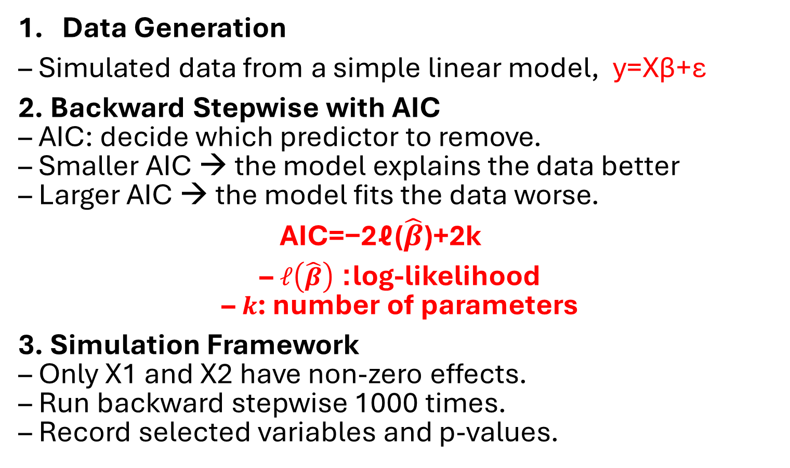
Design Decisions
Data Generation
– Simulated data from a simple linear model, y=Xβ+ε
2. Backward Stepwise with AIC
– AIC: decide which predictor to remove.
– Smaller AIC → the model explains the data better
– Larger AIC → the model fits the data worse.
AIC=−2ℓ(​$\hat{β}$)+2k
– $ℓ\left(\hat{β}\right)$: log-likelihood
– $k$: number of parameters
3. Simulation Framework
– Only X1 and X2 have non-zero effects.
– Run backward stepwise 1000 times.
– Record selected variables and p-values.

Slide 4
1. Current model: y ~ X1 + X2 + X3 + X4 + X5 + X6 + X7 + X8 + X9 + X10 950
2. AIC Values After Removing Each Variable
Variable Removed AIC Value
X1 removed (y ~ X2 + X3 + X4 + X5 + X6 + X7 + X8 + X9 + X10) 980
X2 removed (…) 970
X3 removed (…) 990
X4 removed (…) 925
X5 removed (…) 1005
X6 removed (…) 990
X7 removed (…) 945
X8 removed (…) 952
X9 removed (…) 1002
X10 removed (…) 978
→ removing X4 gives the smallest AIC < 950
model formula = y ~ X1 + X2 + X3 + X5 + X6 + X7 + X8 + X9 + X10
3. Repeating this process until removing any variable no longer reduces AIC
4. Final model: X1 , X2

Slide 5
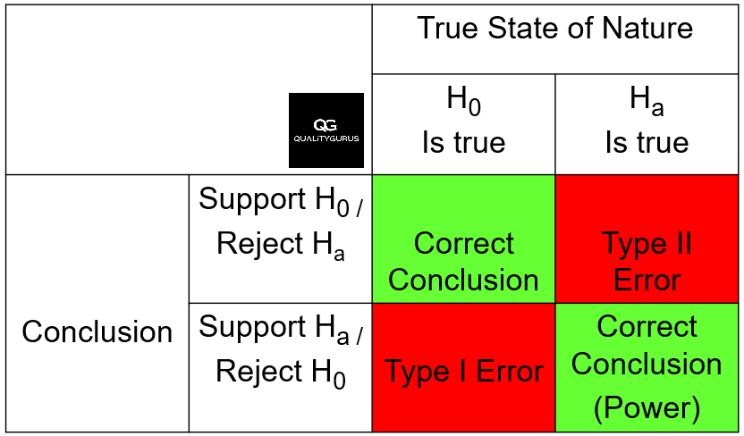
“Backward stepwise AIC selects the real predictors,
but it also selects some noise variables by mistake”
Result
1. X1 and X2 are always selected for the final model with small p-values.
2. Noise variables are sometimes selected and look significant
→ high Type I Error.

Slide 6
Why stepwise inference fails
<An Introduction to Statistical Learning (ISLR)>
“Stepwise selection produces overly optimistic inference and unstable selected models.”
✓ p-values become smaller than they should
✓ selected variables may look significant even when they are not
✓ noise predictors can appear “significant” → false positives
Key point:
Backward stepwise finds the real predictors,
but it makes false positives.
→ We need a way to correct the p values after selection.

